Slide 1

DLite – A Toy Deep Learning Language
Team Members - Broxton Butler, Brayden Keller, EJ Blue, Gavin Newman

Slide 2
Language Highlights
Statically typed with tensor shapes
Broadcasting rules for element-wise ops
Automatic differentiation via grad

Slide 3
Compiler Pipeline
Frontend: Lexer → Parser → AST
Semantic Analysis: Type checking, shape inference
IR: Computation graph representation
Autodiff: Reverse-mode differentiation
Code Generation: Python/NumPy backend

Slide 4
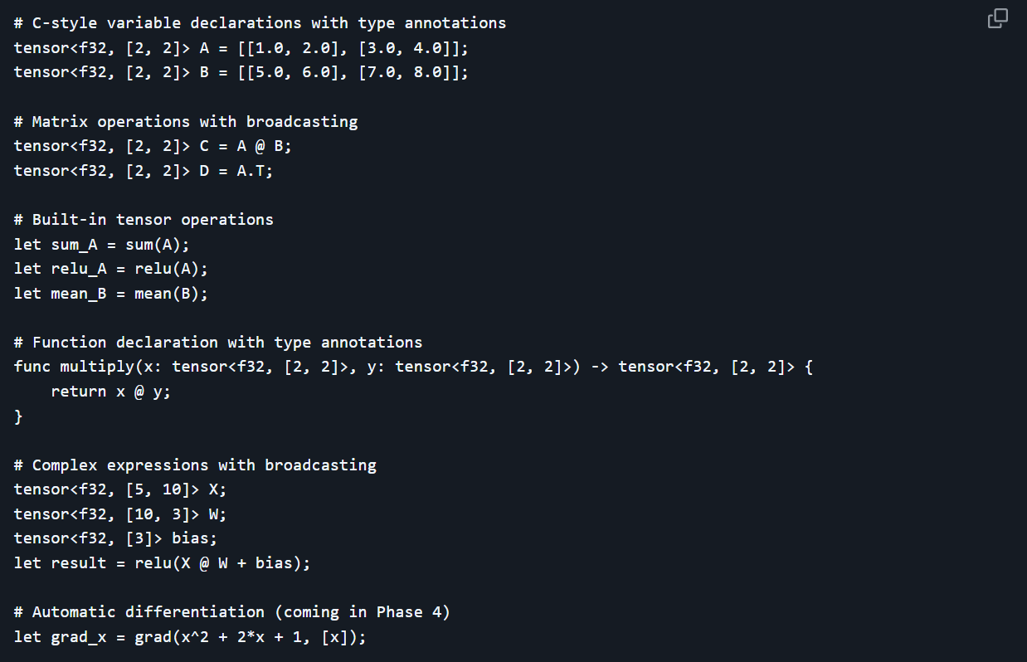
Example DLite Code

Slide 5
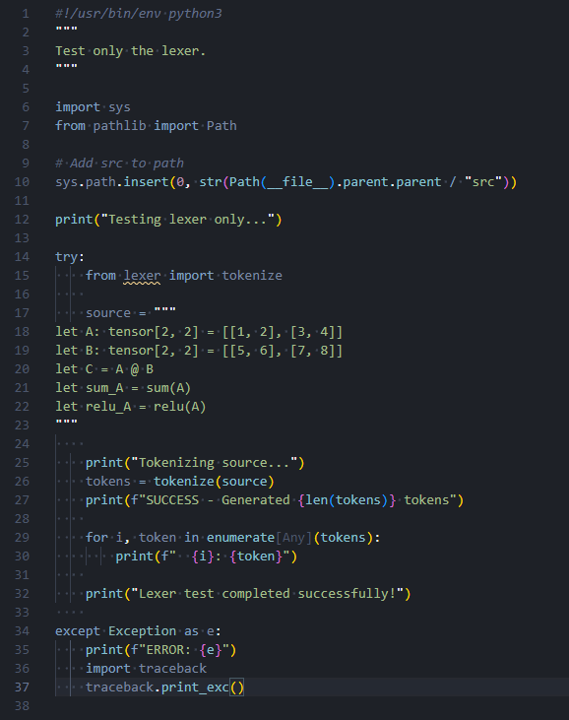
Lexer Testing
Command to run in dev terminal:
python tests/test_lexer_only.py

Slide 6
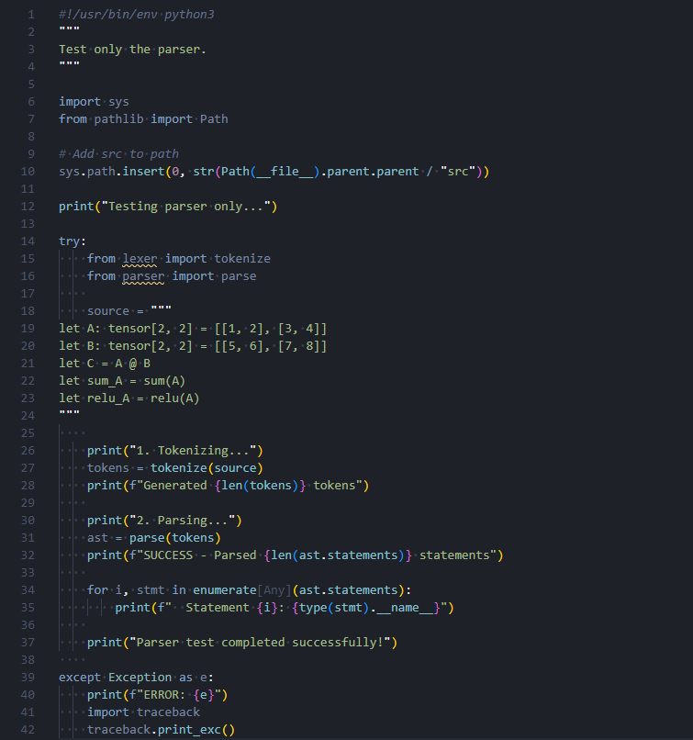
Parser Testing
Command to run in dev terminal:
python tests/test_parser_only.py

Slide 7
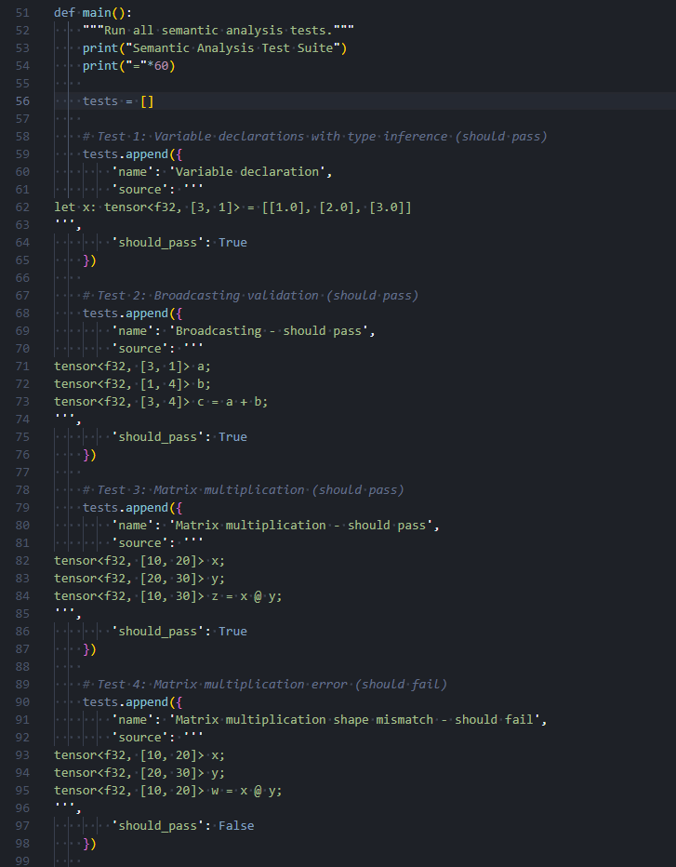
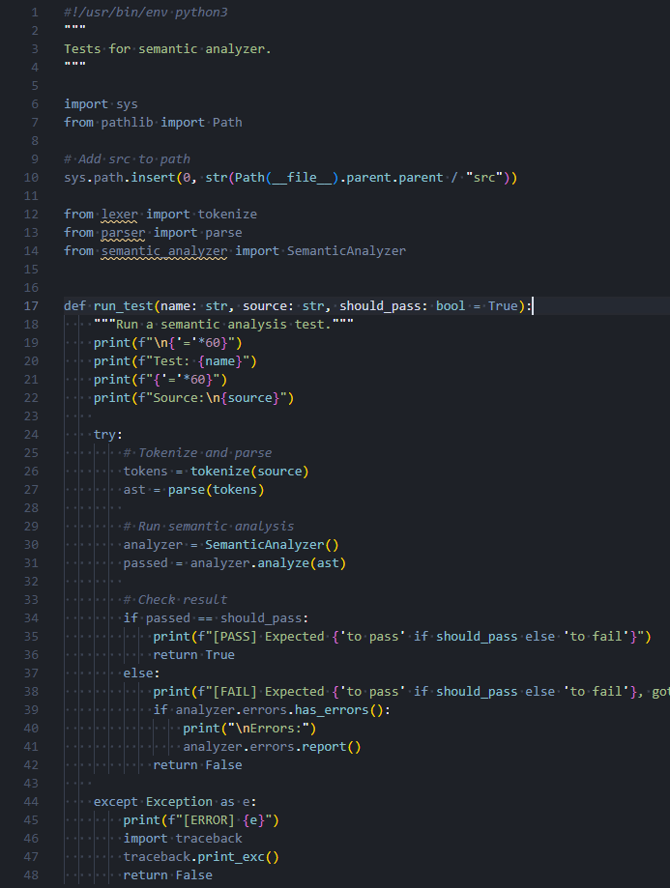
Semantic Analyzer Testing
Command to run in dev terminal
python tests/test_semantic_analyzer.py

Slide 8
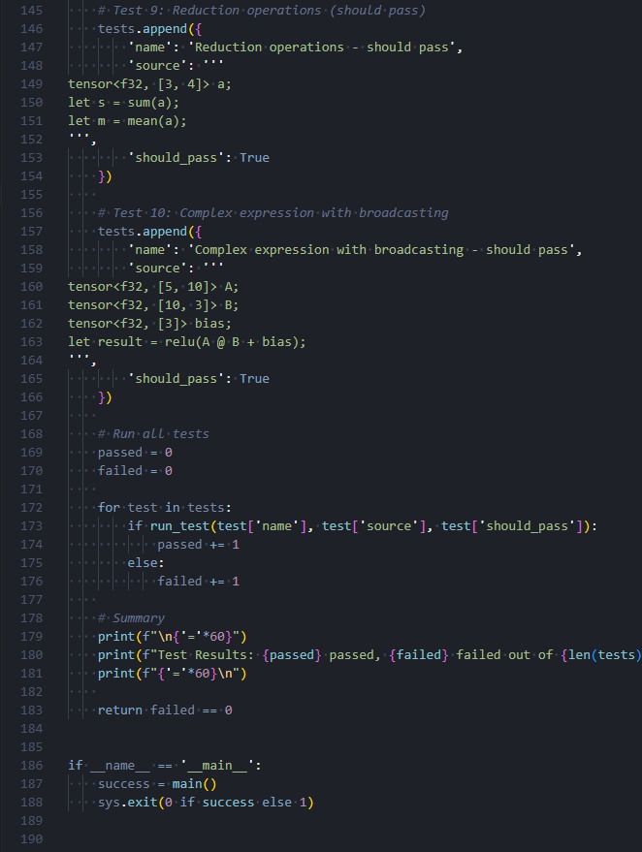
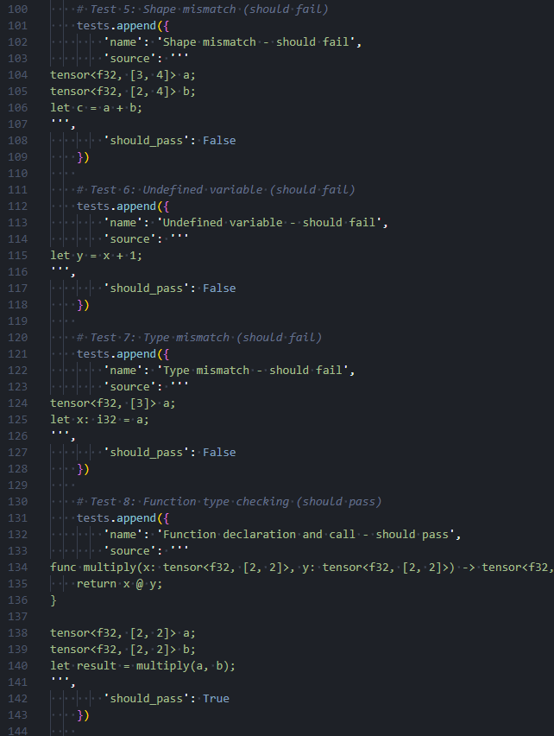
Semantic Analyzer Testing
Cont.

Slide 9
Project Progress
Completed:
Lexer
Parser
Abstract Syntax Tree
Semantic Analyzer
In-progress:
Intermediate Representation
On-deck:
Automatic Differentiation
Code Generation

Slide 10
Project Challenges
Staying coordinated with group members
Understanding the material
Debugging

Slide 11

Questions?

Slide 12

Thank you

